Slide 1
Market Structure

Slide 2
Market Structure - Demand
Population growth rate more than 4% per year.
Consumer preference: quick, quality, clean, convenient, and affordable dining experience.
Customization products (e.g. rice meals for Filipinos, potato fries for Americans)
Domestic:
3-8% annual growth rate in the Philippines
Average annual income of Php 62,000 for “poor” families and Php 268,000 for “rich” households.

Slide 3
Market Structure – Demand (cont.)
Status – Domestic Fast Food:
Entrants of foreign cuisine (e.g. Asian, European, Western)
Jollibee as market leader for Philippine Fast Food
Export:
Jollibee branches in other countries (Middle East, North America, Southeast Asia)
Chowking’s expansion abroad
Projections:
Improving food and service quality over time
Expansion by opening more stores
Product Development

Slide 4
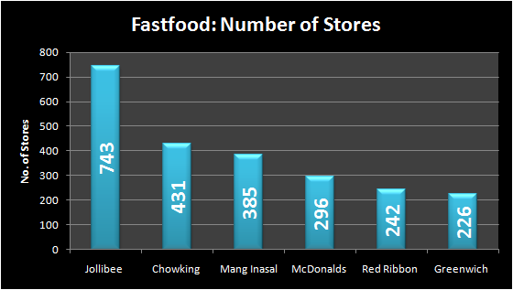
Market Structure – Supply
Mixture of local and foreign brands:
Jollibee (operated by Jollibee Foods)
McDonalds (locally controlled by Alliance Group)
Domestic:
Sources: Annual Reports from JFC and AGI and corporate websites.

Slide 5
Market Structure – Supply (cont.)
Imports:
Rice importation
Other products
Projections:
Largest index of value among other industries
Continuous increase in population
Sales growth of leading brands
Business expansion

Slide 6
Market Structure – Cost and Prices
Cost and Prices:
Ala-carte meals at Php 50-150
Combo meals at Php 82 on the average / Premium items at Php and above
Factor goods (Source: Bureau of Agricultural Statistics, 3/2011)
Commodities | Average Price (in Php)
Potatoes | 60 / kilo
Ground Beef | 240 / kilo
Well-Milled Rice | 35 / kilo
Cooking Oil | 54 / liter
Dressed Chicken | 130 / kilo

Slide 7
Market Structure – Capacity Utilization
Average of 100 seats for dining customers
Number of Consumers: 200 pax / branch / day (at 110 sq. m store size)
Number of Transactions: 100 orders (from 11AM-2PM)
Number of Meals per Transaction: two (2) meals
Source: Mang Inasal Baclaran branch

Slide 8
Financial Structure

Slide 9
Financial Structure
Financial Performance
Jollibee Foods Corp grew a net profit last year by 16 percent to P3.09 billion

Slide 10
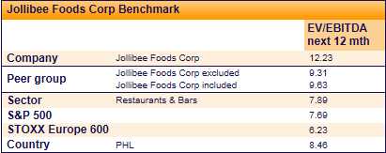
Financial Structure

