Slide 1
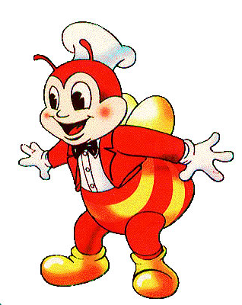
Industry Background

Slide 2
Definition
Prepared and served quickly in a restaurant.
Inexpensive foods.
Begins on the mid-twentieth
In the Philippines, fast-food restaurants specialize fried chicken, French fries, burgers, spaghetti and a beverage.
The largest fast-food industry in the Philippines is the Jollibee food corporation.
Jollibee Corporation is composed of several fast foods chains like Jollibee, Chowking, Greenwich, Red Ribbon and Mang Pepe's.
Quick Service Restaurant or QSR

Slide 3
Fast Food Operation
Structure
Kiosks
Restaurants
Ownership
Company-Owned
Franchise
Food Services
Dine-In
Take-Out
Food Delivery
Drive-Thru
Catering
Bulk Order

Slide 4
Scope and Limitations
Nationwide market coverage
Caters to all ages / broad market segment
Slow service vs. commitment to quick food preparation
Menu is limited to the products the store offers
Lack of food stock
Space for fast food is small
Capacity is 100 sq m at the minimum
Cleanliness of the store sometimes is not properly maintained due to underman staff.

Slide 5
Total Industry
Regulated by the Department of Trade and Industry.
RA 7394 or the Consumer Act of the Philippines.
Department of Health and Bureau of Food and Drugs
According to Omana (2005), the fast-food market is dominated by the Filipino-owned Jollibee Foods Corporation with 52% market share.
It is being followed by American food brands like McDonald’s, Wendy’s, Burger King, and KFC.

Slide 6
Key Player / Brands
Fast Food
Jollibee
Mc Donalds
Green wich
Mang Inasal
Chow king
Red Ribbon
Goldi locks
KFC
Burger King
Jollibee Food Brands

